Slide 1

卒業プロジェクト – Capstone Project
Useful Japanese Dictionary for Vietnamese
スーパーバイザ: Nguyễn Văn Sang Supervisor リーダー : Lê Đình Nam – SE02316 Leader メンバー: Phạm Thị Minh – SE02300 Member Phạm Tiến Đạt – SE02336 Nguyễn Ngọc Tuấn–SE02189

Slide 2
コンテンツの概要 – Outline of Content
1. 導入 – Introduction
2. プロジェクト管理 – Project Management
3. ソフトウェア要求仕様 – Software Requirement Specification
4. ソフトウェア設計説明書 – Software Design Description
5. 品質管理 – Quality Control
6. プロジェクト結果 – Project Result
7. デモ – Demo
8. 質問と回答 – Q & A

Slide 3
1.導入 - Introduction
1.2 在のウェブサイト - Existing Websites
1.3 アイデア - Idea
1.4 提案 - Proposal
1.1 現在状況 - Current Situation

Slide 4
1.1 現在状況 - Current Situation
現在日本語の勉強は注目されています－Learning Japanese is trend nowadays
There are more online learning websites
BUT
Website of Vietnam not much. Almost is website of training center and it requires upgrading account to learn
If free, website does not abundant document and not suitable for everyone

Slide 5
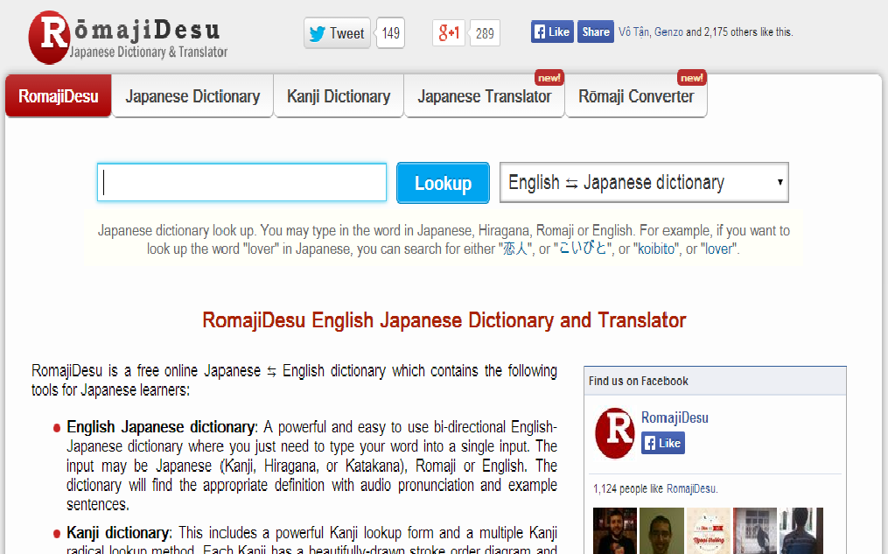
1.2 在のウェブサイト - Existing Websites
☺ Having a huge database to search. Specially KANJI
BUT
English language
No support reading document,
No support practice
No support listening conversation
http://www.romajidesu.com

Slide 6
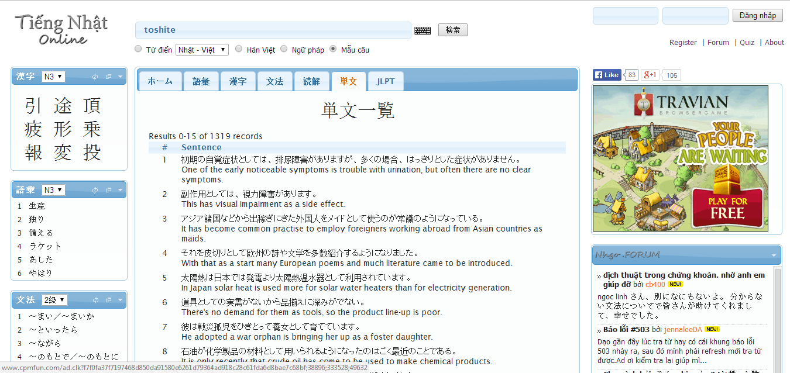
1.2 在のウェブサイト - Existing Websites
☺ Search with more option.
But some word don’t have Vietnamese meaning
☺ Support post question
BUT
No support Viet-Nhat dictionary
No support listening conversation
Advertisement make noisy
http://www.nhgo.net

Slide 7
1.3 アイデア - Idea
Build a website with:
Vietnamese language
Suitable for everyone, from beginner
100% Free
Support full features
Support full levels: N5 ->N1

Slide 8
1.4 提案 - Proposal
Support Vietnamese language
Friendly interface
No need upgrading account
Search with more option
Reading more documents type
Listening conversation
Practice
Receive contributions from user

Slide 9
2.プロジェクト管理 - Project Management
2.1 ソフトウェ アプロセス モデル - Software Process Model
2.2 プロジェクト組織 - Project Organization
2.3 プロジェクト計画 - Project Schedule
2.4 目標 と 成果物 - Objectives & deliverables
2.5ツールと インフラストラクチャ - Tools & Infrastructure
2.6リスク管理 - Risks management
2.7 コンフィグレーション管理 - Configuration management
2.8 コミュニケーション管理 - Communication management

Slide 10
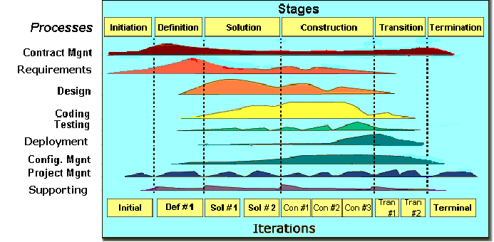
2.1 ソフトウェ アプロセス モデル - Software Process Model

Slide 11
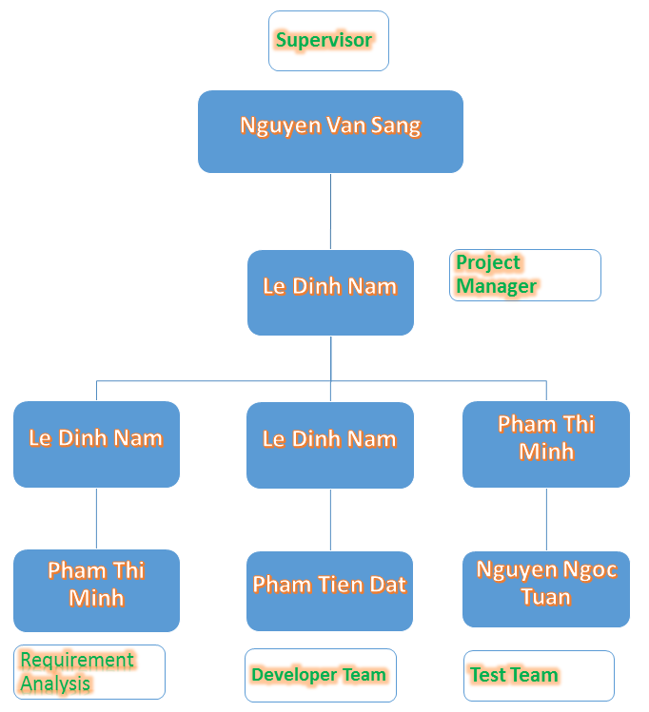
2.2 プロジェクト組織 - Project Organization

Slide 12
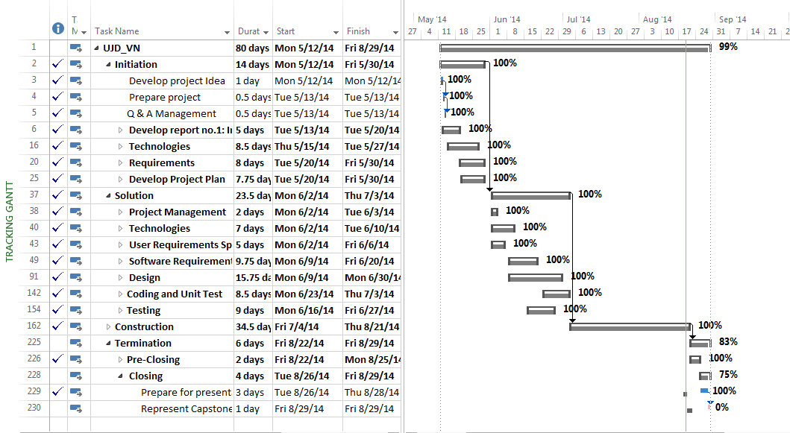
2.3 プロジェクト計画 - Project Schedule

Slide 13
2.4 マイルストーンの成果物 – Deliverables Milestone
No | Stage | Committed Delivery date | Description of Deliverable | Delivery media
Initiation |  |  | Requirements agreed, Report 1 reviewed
1 | Submit Project Introduction | 20-5-2014 | Completed Project Introduction | Commit SVN
2 | Submit Project Plan Final | 28-05-2014 | Criteria: Documentation reviewed | Commit SVN
Solution
1 | Architecture Design | 12-6-2014 | Criteria: Documentation reviewed | Commit SVN
2 | Screen Design | 10-06-2014 | Criteria: Documentation reviewed | Commit SVN
3 | Class Design | 11-06-2014 | Criteria: Documentation reviewed | Commit SVN
4 | Data Design | 11-6-2014 | Criteria: Documentation reviewed | Commit SVN
5 | SRS Final | 20-06-2014 | Criteria: Documentation reviewed | Commit SVN
Construction |  |  | Product developed & tested and released to supervisor, documentation reviewed.
1 | Submit Test Plan Final | 23-06-2014 | Completed report no.5 | Commit SVN
2 | Complete Coding and Unit Test | 24-07-2014 | Source code Acceptance criteria: Product unit tested | Commit SVN
3 | Complete Testing | 31-07-2014 | Completed Test | Commit SVN
4 | Submit User Manual Final | 11-08-2014 | Completed report no.6 | Commit SVN
5 | Submit the last document and CD source code | 21-08-2014 | Final Documents and Source Code | Copy to CD and commit
Termination |  |  | Project post-mortem is conducted, Project assets archived and released to supervisor
1 | Represent capstone project | 30-08-2014 | Criteria: Completed | Presentation
2 | Project Complete | 30-8-2014 | Criteria: Completed

Slide 14









2.5ツールと インフラストラクチャ - Tools & Infrastructure
ツール - Tools:
Word 2013
Excel 2013
Project 2013
Power Point 2013
Chorme
Coc Coc
TortoiseSVN
Xampp
Atash

Slide 15
2.6リスク管理 - Risks management
Risk ID | Risk Source | Risk Category | Risk Description | Probability | Impact | Exposure | Priority | Trigger | Risk Status | Mitigation | Contingency | Person in charge
R01 | Project Requirement | Not meeting performance requirements | Quality of document which is wrote by Japanese maybe not good | 0.3 | 2 | 0.6 | 4 | Member don’t know more Japanese. | Open | 1. Create plan to training Japanese for member from beginning of project. |  | Team member
 |  |  |  |  |  |  |  |  |  | 2. Using English instead of Japanese (if can). |  | Team member
 |  |  |  |  |  |  |  |  |  | 3. When deliver documents to customer can write by two languages: English and Japanese. |  | Team member

Slide 16
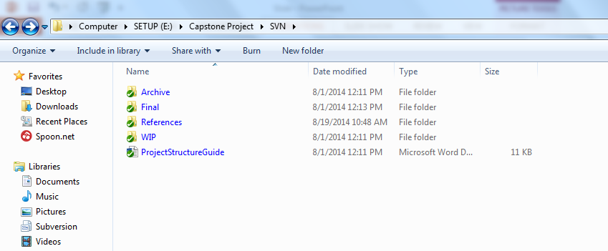
2.7 コンフィグレーション管理 - Configuration management

Slide 17
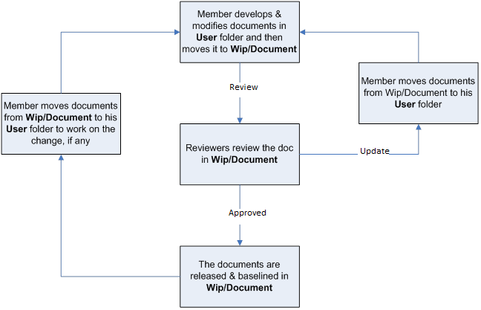
2.7 コンフィグレーション管理 - Configuration management
ドキュメント - Document

Slide 18

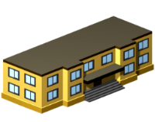






2.8 コミュニケーション管理 - Communication management
労働時間 : 8時間/日、5日/週 - Time: 8 hours/day, 5 days/week.
場所 : 学校、家庭 - Location: school, home
コミュニケーション - Communication
ミーティング議事録 -Meeting minutes

Slide 19
3. ソフトウェア要求仕様 - Software Requirement Specification
システムのユーザ - System Users
3.3
機能要求 - Functional Requirements
3.4
非機能要求 - Non-Functional Requirements
3.1
3.2
ビジネスプロセ - Business Process

Slide 20
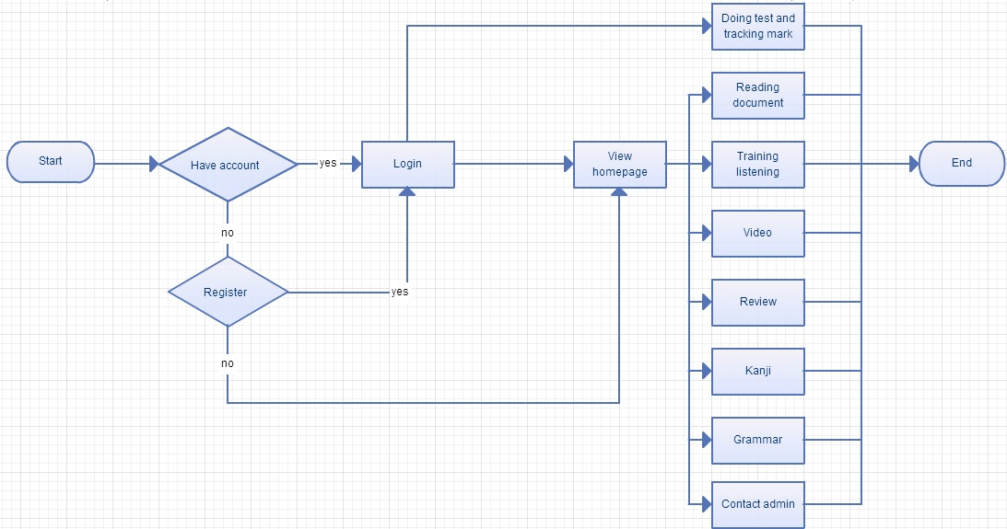
3.1 ビジネスプロセ - Business Process

Slide 21


3.2 システムのユーザ - System Users
2役者があります - There are 2 actors:
ユーザー
User
管理者
Administrator

Slide 22
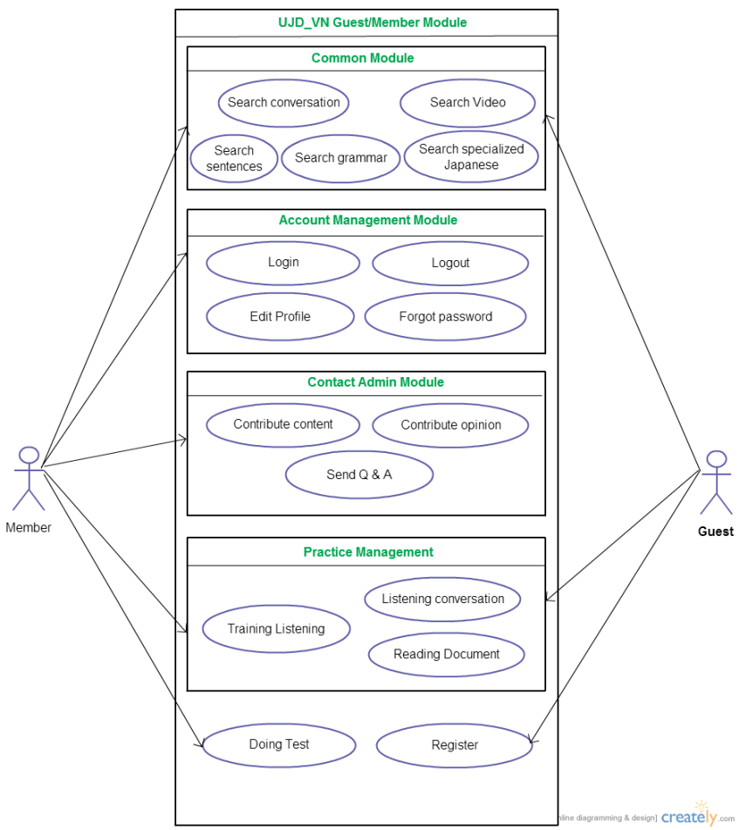
3.3 機能要求 - Functional Requirements
User Module
アカウントの管理 - Manage Account
コモン·モジュール - Common module
コンタック·アドミン - Contact admin
プラクティス·マネージメント - Practice management
ユーザーのユースケース - User use-case
全部: 17ユースケース - Total: 17 use-case

Slide 23
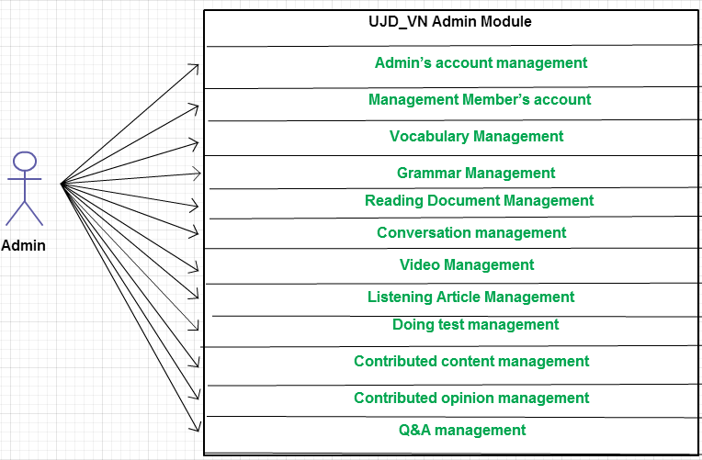
3.3 機能要求 - Functional Requirements
Admin Module
データベースマネージメント
- Database management
コンタクトマネージメント
- Contact management
管理のユースケース - Admin use-case
全部 ：39 ユースケース - Total: 39 use-cases

Slide 24
3.4非機能要求 - Non-functional Requirements
1.ユーザーインターフェース - User Interfaces
友好的で簡単な界面 - Friendly and simply interface
色が上品で、派手ではありません - The color is elegant, not flashy
言語はベトナム語と日本語です - Language is Vietnamese, Japanese

Slide 25

3.４非機能要求 - Non-functional Requirements
2.ソフトウェア要求 - Software Requirements

Slide 26
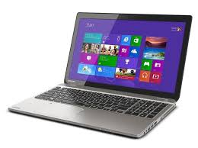


3.3非機能要求 - Non-functional Requirements
3. ハードウェア要求 - Hardware Requirements
PC, ラップトップは インターネット接続があります。
- PC, Laptop with internet connection.

Slide 27
3.4非機能要求 - Non-Functional Requirement
1. 確実 - Reliability
失敗の間 - Mean time between failures
修復の間 - Mean time to repair
2. 実行·要件 - Performance Requirements
可用性 - Availability
切り換え時 - Response time
3. ユーザビリティ - Usability
使用効率 - Efficiency of use
直観 - Intuitiveness
4. 担保要件 - Security Requirements
ユーザー層 - User layer
データ層マネジ - Manage Data Layer
蓄えたデータ - Stored Data

Slide 28
4. ソフトウェア設計記述 - Software Design Description
4.1
テクノロジー と 理由 - Technology & Reason
4.2
アーキテクチャ表現 - Architecture Representation
4.3
パッケージを見る - Package View
4.4
詳細設計 - Detail Design
4.5
データベース設計 - Database Design

Slide 29
4.1 テクノロジー と 理由 - Technology & Reason
テクノロジー - Technology: PHP Codeigniter
理由 - Reason:
- UJDシステムと一致する - Consistent with UJD system
- MVCモデルに基づいて設計 - Designed according to the MVC Model

Slide 30
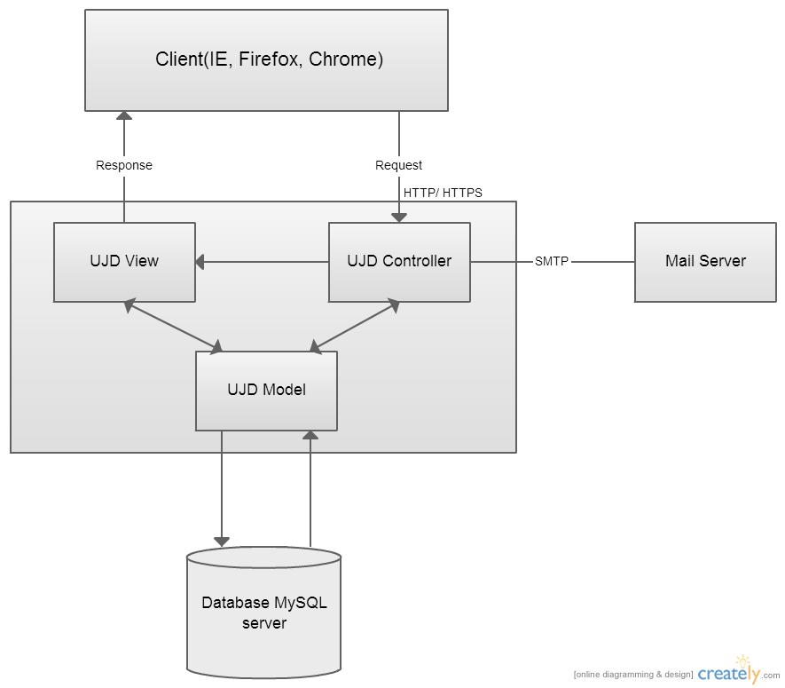
4.2アーキテクチャ表現 -Architecture Representation
UJD_VN システム全体のアーキテクチャ
(UJD_VN system overall architecture)

Slide 31
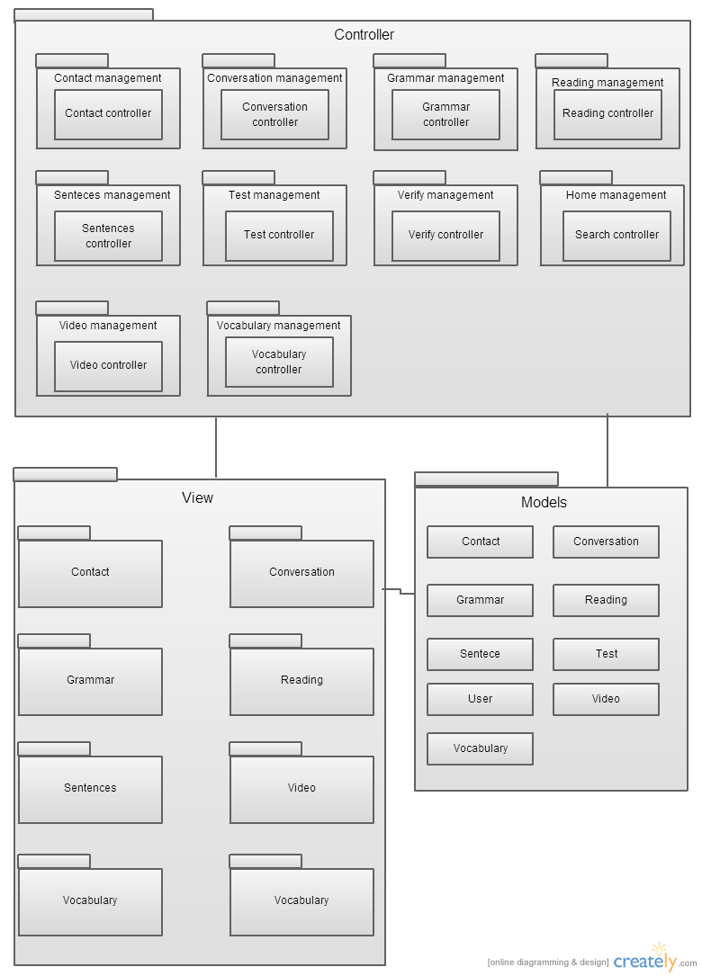
4.3 パッケージを見る - Package View
パッケージを見る - Package View

Slide 32
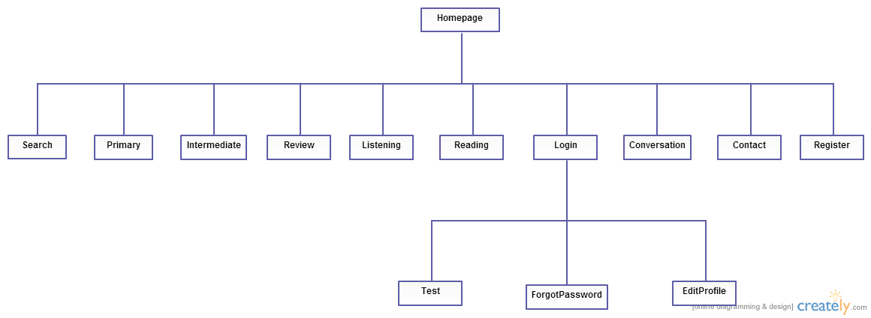
4.4.1 画面設計 - Screen Design
メインアプリケーションの画面の流れ
- Main Application screen flow

Slide 33
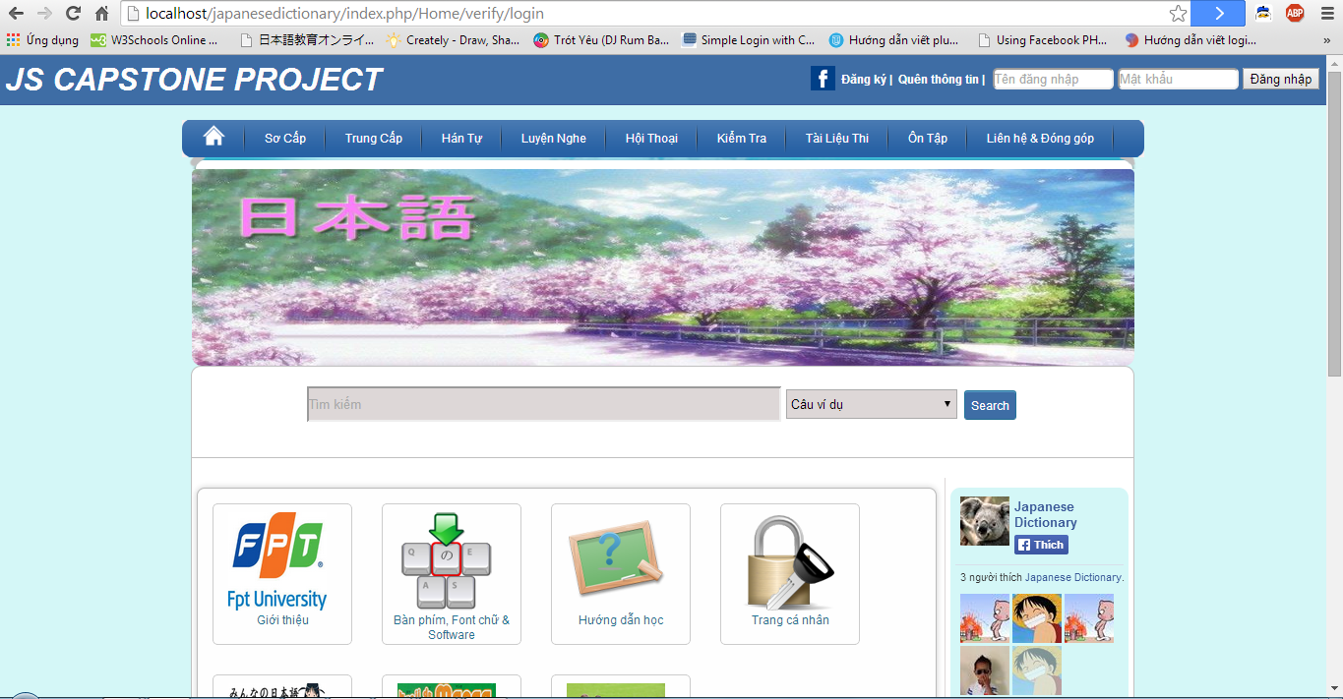
4.4.1 画面設計 - Screen Design
ホームページの画面設計 - Homepage screen design

Slide 34
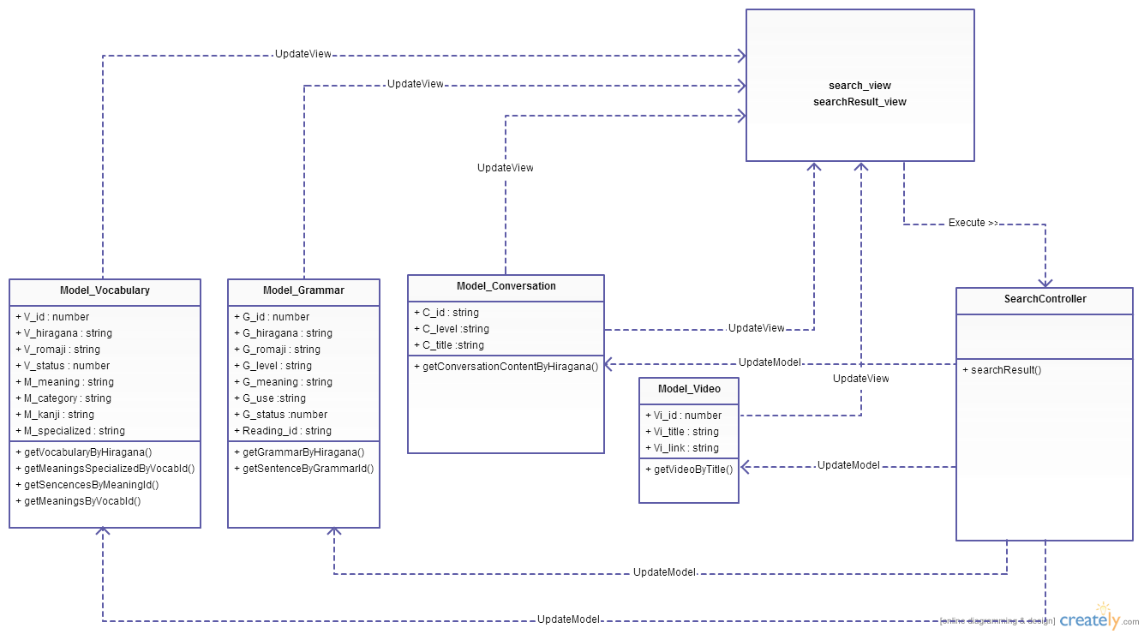
4.4.2 クラス設計 - Class Design
一般的なクラス設計 - Common Class Design

Slide 35
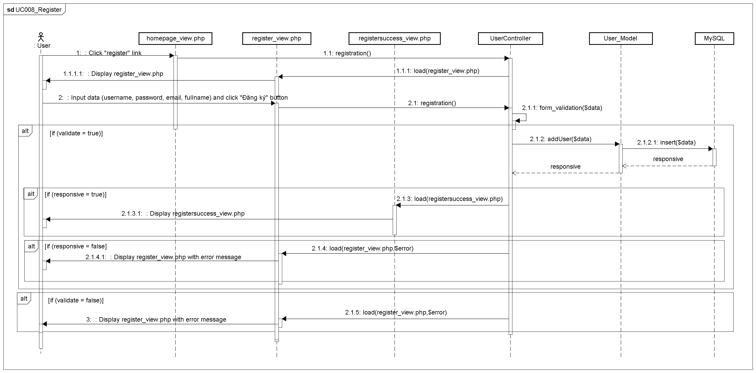
4.4.3 シーケンス図 - Sequence Diagram
レジスタ シーケンス図 - Register sequence diagram

Slide 36
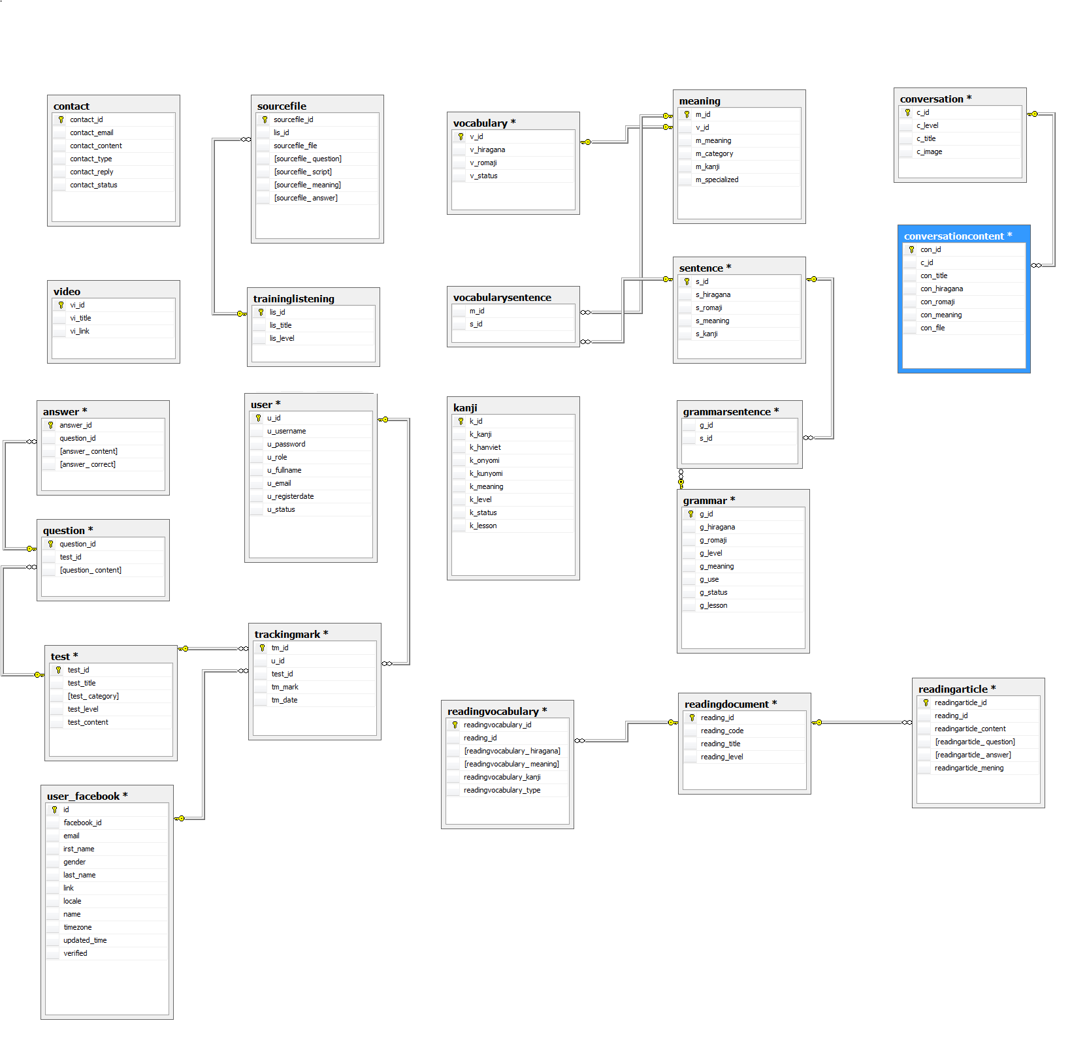
4.5 データベース設計 - Database Design

Slide 37
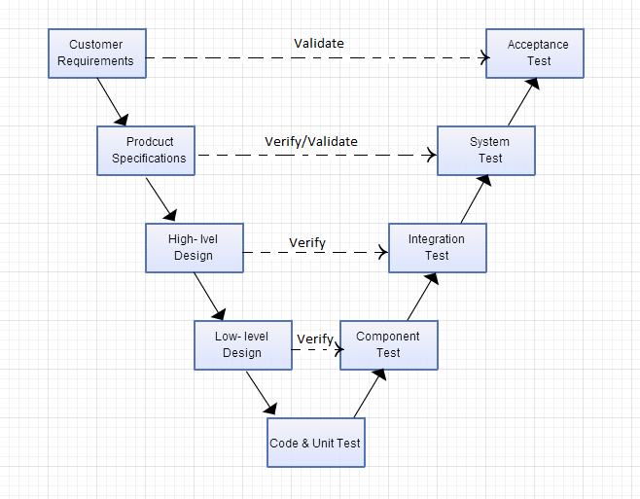
5. 品質管理 - Quality Control
V モジュール - V-module

Slide 38
5. 品質管理 - Quality Control
5.1 レビュー - Review
5.1.1 要求仕様 - SRS
5.1.2 設計 - Design
5.1.3 コーディング
- Coding
5.2 テスティング - Testing
5.2.1 テストの計画
-Test Plan
5.2.2 テストプロセス - Test Process
5.2.3 テストレポート - Test Report
5.1.4 テスト -Testing
5.1.1 プロジェクト計画 - Project Plan

Slide 39
5.1 レビュー - Review
Design Review Checklist - Low level Design (Detailed Design)
Project Code: UJD_VN
Version of the work product: v1.0
Reviewer(s): Mr. SangNV, Project team
Review date: 08/07/2014
Work product' size
Effort spent on review (man-hour): 5
Question | Yes | No | N/A | Note | Priority | Severity
CONTENT
Screen design: Does screen designs (if any) satisfy the requirements specified in other documents (SRS, Requirement, Architecture Design) ?
Does it describe GUI of the system as follows:
Does it describe/layout position of all items in GUI? | x
Does it describe processes or actions for GUI? | x
Does it describe relationship between items in GUI and modules or public functions? | x
Are the inputs and outputs for all the interfaces are sufficient and necessary? | x
デザインレビュー - Design review

Slide 40
5.1 レビュー - Review
 |  |  | Defect (No of Def/KLOC)
# | Product | Quality Control Activity | Plan | Actual
1 | Test case | Unit Test | 3-4 | 18
 |  | Component Test | 3-4 | 16
 |  | IT | 2-3 | 9
 |  | System test | 4-6 | 13
 |  | Leakage (UAT) | 1-2
2 | Requirements | Review | 10 | 6
3 | Design | Review | 15 | 21
4 | Code | Review | 30 | 15
5 | Project Plan | Review | 10 | 3
6 | Project Schedule | Review | 10 | 6
7 | Test Plan | Review | 10 | 4
8 | Other document | Review | 15 | 10
Total |  |  |  | 121
品質レポートー - Quality report

Slide 41
5.2.1 テストの計画 - Test Plan
テストアプローチ - Test Approach:
Unit Test: Developer
Component Test: Tester
Integration Test: Tester
System Test: Tester
Acceptance Test: Customer
テスト環境 - Test Environment:
Web :Chrome 35, CocCoc 35

Slide 42
5.2.1 テストの計画 - Test Plan
Milestone Task | Effort (pd) | Start Date | End Date
Create Test Plan | 6 | 16/06/2014 | 22/06/2014
Review & update TP | 2 | 23/06/2014 | 23/06/2014
Create Component Test case | 12 | 23/06/2014 | 26/06/2014
Review & update Component TC | 2 | 27/06/2014 | 27/06/2014
Create Integration Test case | 2 | 07/07/2014 | 07/07/2014
Review & Update Integration TC | 2 | 08/07/2014 | 08/07/2014
Create System Test case | 6 | 09/07/2014 | 11/07/2014
Review & Update System TC | 2 | 11/07/2014 | 11/07/2014
Execute Component test phase 1 | 1 | 16/07/2014 | 16/07/2014
Execute Component test phase 2 | 1 | 24/07/2014 | 24/07/2014
Execute Integration test phase 1 | 2 | 17/07/2014 | 17/07/2014
Execute Integration test phase 2 | 2 | 25/07/2014 | 28/07/2014
Execute System test phase 1 | 4 | 21/07/2014 | 22/07/2014
Execute System test phase 2 | 4 | 28/07/2014 | 29/07/2014
テスト節目- Test Milestone

Slide 43
5.2.1 テストの計画 - Test Plan
Worker/Doer | Role | Specific Responsibilities/Comments
MinhPT | Test Leader | Manage Test Resource and assign test tasks. Create and review Test Plan. Create and review Test Case. Execute test. Create and review Test Report
TuanNN | Tester | Create and review Test Case. Execute test. Create Test view points Create and review Test Report
リソース - Resource

Slide 44
5.2.2 テストのプロセス - Test Process
Create Test Plan
Base on SRS to create test plan:
Features to be tested
Environment
Schedules
Responsibilities
Risks and contingencies
…
Create Test Case
Review Test Case
Execute Test
Log Bug
Retest
Create Test Report

Slide 45
5.2.2 テストのプロセス - Test Process
Create Test Plan
Base on SRS, test viewpoint to create test case:
Component test case
Integration test case
System test case
Create Test Case
Review Test Case
Execute Test
Log Bug
Retest
Create Test Report

Slide 46
テストケース - Test case
Module Code | Practice management
Test requirement | This test cases were created to test Practice management module.
Tester | TuanNNSE02189
Pass | Fail | Untested | N/A | Number of Test cases
0 | 0 | 229 | 0 | 229
ID | Test Case Description | Test Case Procedure | Expected Output | Inter-test case Dependence | Result | Test date | Note
 | Doing test
[Practice management-] | Test viewing "Kiểm tra\ Đề kiểm tra trắc nghiệm N4" form. | 1. Login the system with Member role. 2. Click "Kiểm tra\ Đề kiểm tra trắc nghiệm N4" tab in homepage. | 1. The Homepage is displayed 2. The "Đề kiểm tra N4" view form is displayed with the following informations: list of small test N4 link : - Grammar test - Listening test - Vocabulary test - Reading test | [Account Management Module- 4]
[Practice management-1] | Test viewing "Kiểm tra\ Đề kiểm tra trắc nghiệm N3" form. | 1. Login the system with Member role. 2. Click "Kiểm tra\ Đề kiểm tra trắc nghiệm N3" tab in homepage. | 1. The Homepage is displayed 2. The "Đề kiểm tra N3" view form is displayed with the following informations: list of small test N3 link: - Grammar test - Listening test - Vocabulary test - Reading test | [Account Management Module- 4]

Slide 47
5.2.2 テストのプロセス - Test Process
Create Test Plan
Developer self-review: Unit test case
Tester self-review and peer-review:
Component test case
Integration test case
System test case
Create Test Case
Review Test Case
Execute Test
Log Bug
Retest
Create Test Report

Slide 48
テストレビュー - Test case review checklist
Project Code: UJD_VN
Version of the work product: v1.0
Reviewer(s): MinhPTSE02300
Review date: 08/07/2014
Work product's size: 5 sheets
Effort spent on review (person-hour): 2
Question | Yes | No | N/A | Note | Priority
DOCUMENT CONTROL
Verify whether document control procedures have been followed by checking for the following:
Does the title page contain the document name, version number, release date and issued date? | x
Does the header and footer correctly specify the name, and version of the document? | x
Does the page – numbering scheme indicate the total number of pages in the document? | x
Is the history traceable? | x |  |  |  | Mandatory
Does it include list of reference documents? | x
Are all documents checked Spelling and Grammar in MS Word or similar tools? | x

Slide 49
5.2.2 テストのプロセス - Test Process
Create Test Plan
Tester execute test case follow phase:
Component testing
Integration testing
System testing
Create Test Case
Review Test Case
Execute Test
Log Bug
Retest
Create Test Report

Slide 50
テストケースの実行 - Execute test case
Module Code | Practice management
Test requirement | This test cases were created to test Practice management module.
Tester | TuanNNSE02189
Pass | Fail | Untested | N/A | Number of Test cases
229 | 0 | 0 | 0 | 229
ID | Test Case Description | Test Case Procedure | Expected Output | Inter-test case Dependence | Result | Test date | Note
 | Doing test
[Practice management-] | Test viewing "Kiểm tra\ Đề kiểm tra trắc nghiệm N4" form. | 1. Login the system with Member role. 2. Click "Kiểm tra\ Đề kiểm tra trắc nghiệm N4" tab in homepage. | 1. The Homepage is displayed 2. The "Đề kiểm tra N4" view form is displayed with the following informations: list of small test N4 link : - Grammar test - Listening test - Vocabulary test - Reading test | [Account Management Module- 4] | Pass | 29/7/2014
[Practice management-1] | Test viewing "Kiểm tra\ Đề kiểm tra trắc nghiệm N3" form. | 1. Login the system with Member role. 2. Click "Kiểm tra\ Đề kiểm tra trắc nghiệm N3" tab in homepage. | 1. The Homepage is displayed 2. The "Đề kiểm tra N3" view form is displayed with the following informations: list of small test N3 link: - Grammar test - Listening test - Vocabulary test - Reading test | [Account Management Module- 4] | Pass | 29/7/2014

Slide 51
5.2.2 テストのプロセス - Test Process
Create Test Plan
While executing test, Tester detect, log bug and assign to appropriate developer.
Create Test Case
Review Test Case
Execute Test
Log Bug
Retest
Create Test Report

Slide 52
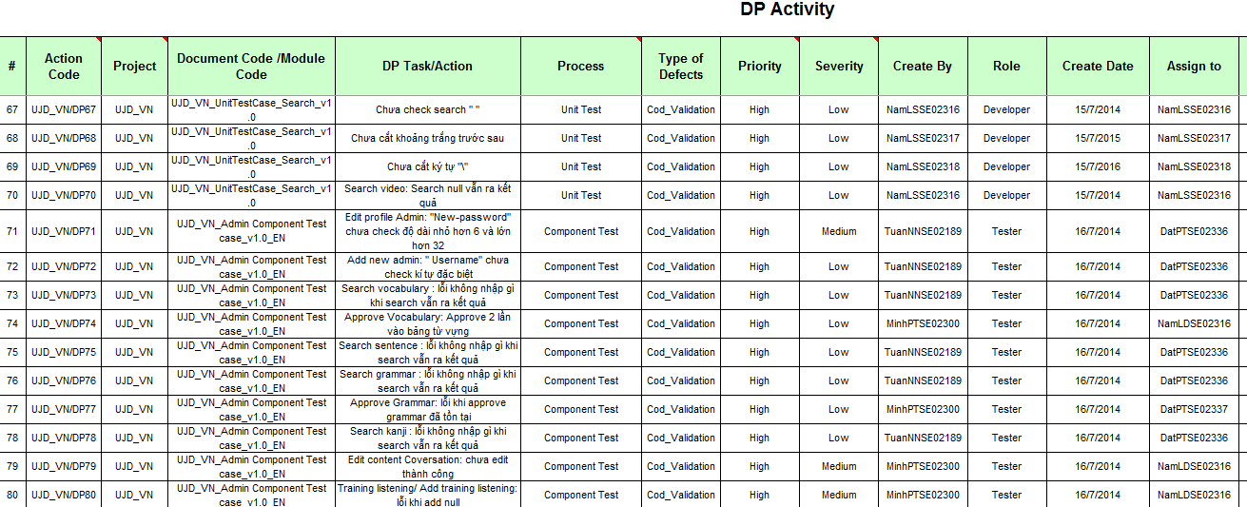
不具合管理 - Defect log management

Slide 53
5.2.2 テストのプロセス - Test Process
Create Test Plan
When Developer fixed bug, Tester re-test until bug was fixed successfully, then change defect of status to Closed.
Create Test Case
Review Test Case
Execute Test
Log Bug
Re-test
Create Test Report

Slide 54
5.2.2 テストのプロセス - Test Process
Create Test Plan
Tester has responsibility to write test report for each test phase . Finish testing phase, Test leader create Test report
Create Test Case
Review Test Case
Execute Test
Log Bug
Retest
Create Test Report

Slide 55
5.2.3 テストのレポート - Test Report
Phase | # Test cases Planned (TC/KLOC) | #Defects Planned (DP/KLOC) | #Test cases Actual (TC/KLOC) | #Defects Actual (DP/KLOC) | % Tests Executed | % Tests Passed | % Tests Fail
Unit Test | 40 | 3 -4 | 542 | 18 | 100% | 100% | 0%
Component Test | 40 | 3 -4 | 751 | 16 | 100% | 100% | 0%
Integration Test | 30 | 2 -3 | 284 | 9 | 100% | 100% | 0%
System Test | 60 | 4 -6 | 1493 | 13 | 100% | 100% | 0%
Total | 3400 | 240 - 340 | 3070 | 56 | 100% | 100% | 0%

Slide 56
5.2.3 テストのレポート - Test Report
Phase | Round 1 |  |  |  | Round 2
 | Pass | Fail | Untested | Bug | Pass | Fail | Untested | Bug
Unit Test | 439 | 0 | 0 | 14 | 103 | 0 | 0 | 4
Component Test | 477 | 0 | 0 | 12 | 274 | 0 | 0 | 4
Integration Test | 118 | 0 | 0 | 6 | 166 | 0 | 0 | 3
System Test | 996 | 0 | 0 | 6 | 497 | 0 | 0 | 7
Total | 2030 | 0 | 0 | 38 | 1040 | 0 | 0 | 18

Slide 57
5.2.3 テストのレポート - Test Report
Defects | Logged | %Closed | %Invalid | %Open
Critical | 0 | 0% | 0% | 0%
High | 0 | 0% | 0% | 0%
Medium | 11 | 100% | 0% | 0%
Low | 45 | 100% | 0% | 0%
Total | 56 | 100% | 0% | 0%
不具合レポート- Defect Report

Slide 58
6. プロジェクト結果 – Project Result
Main objective | Develop a system which will provide to users functionality to search and reading document online and the other users log-in and do the test.
Purpose | Provide a UJD_VN online on website.
Source Repository | https://japanesedictionary.googlecode.com/svn/trunk/
 | Plan | Actual
Start Date | 12/05/2014 | 12/05/2014
End Date | 22/08/2014 | 30/08/2014
Releases version | 1.0 | 1.0
Duration | 75 | 81
Effort (person-day) | 2400 | 2464
Test cases | 2600 | 2528
Defects | 240-340 | 56
Document pages | 1500 pages | 2000 pages
Lines of code | ~20000 | ~ 24000
比較 - Comparison

Slide 59
制限と期待 – Limitation & Expectation
現在の制限 - Current Limitations | 将来 に 期待 - Expectation in Future
Have not Mobile version Not support English language Not have money for up load website to Host | Upload to host that user easy to use Get attracting from user who care Japanese Commercialized product

Slide 60
学んだ教訓 - Lessons Learnt
日本のスタイル - Japanese style
チームワーク - Working in group
実際に知識を入れます - Putting knowledge in practice
新技術でコーディングスキルを改善します - Improve coding skill with new technology

Slide 61
7. デモ - Demo

Slide 62

8. 質問と回答 - Q & A

Slide 63


